Slide 1
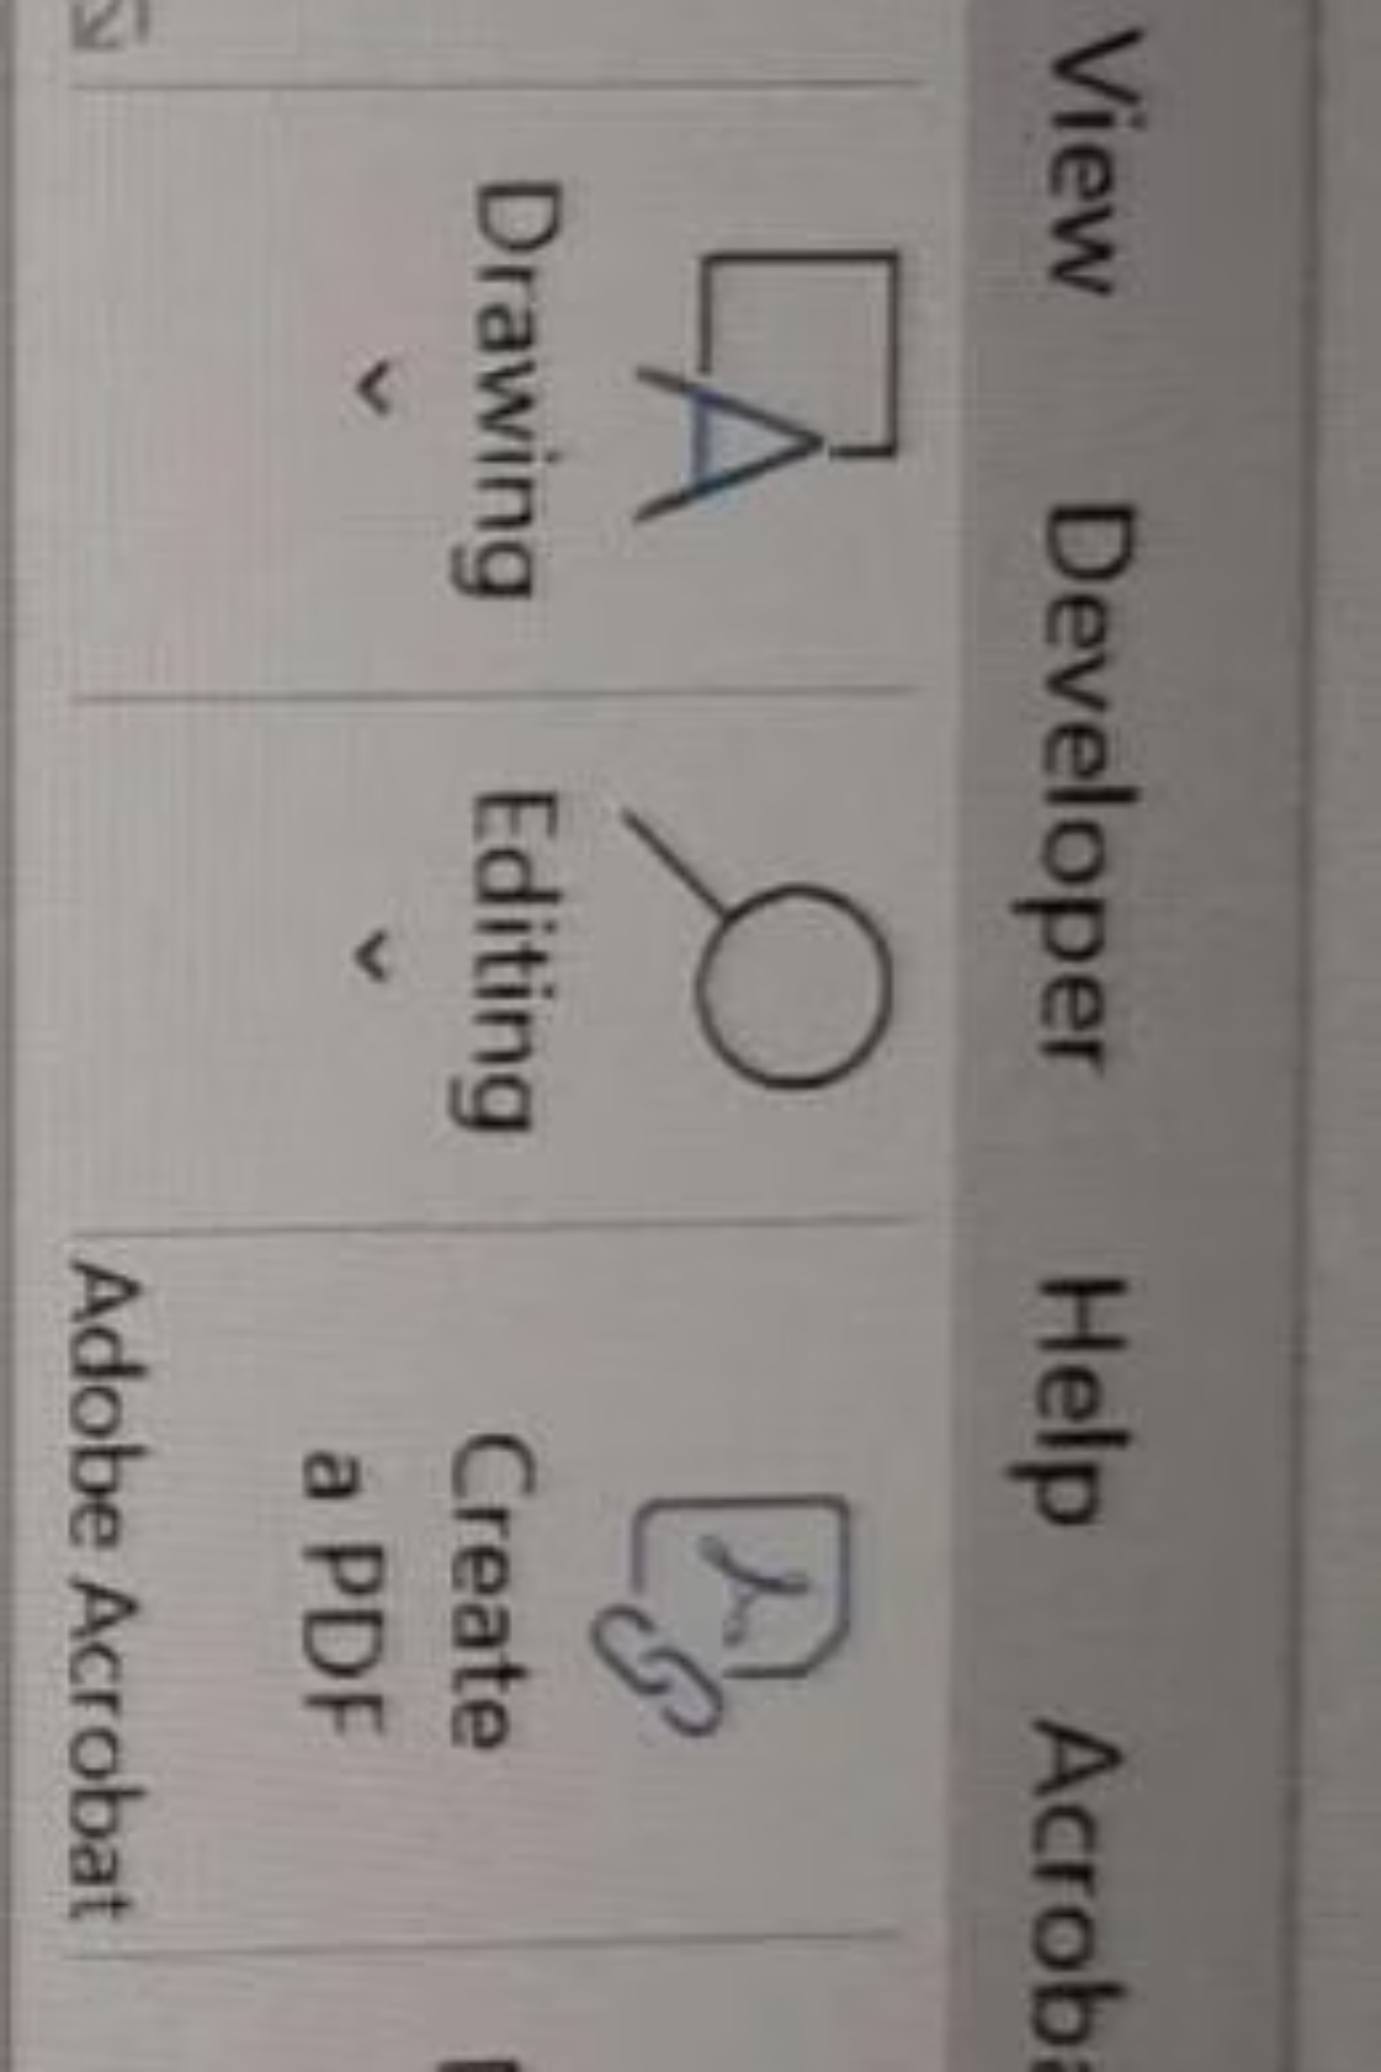
Migration from Excel to Python
Transforming data processing workflows for enhanced efficiency and scalability

Slide 2

Agenda
01
02
Excel vs Power BI vs Python
Team Structure
Comprehensive comparison of data processing tools
Overview of project teams and members
03
Project Timeline
11-week implementation roadmap

Slide 3
Excel vs Power BI vs Python
Excel
Power BI
Python
Pros:
Pros:
Pros:
Processes small data faster
Processes large data faster
Processes large data faster
Quick validation and adhoc checks
Cons:
Highly scalable and automatable
Easy validations and testing
Familiar to all users
Difficult to understand DAX
Can create GUI for non-technical users
Manual output copying required
Cons:
Difficult to validate and debug
Performance issues with large data (above 100K rows)
Cons:
Not ideal for row-level processing
Requires Python and libraries installed
Complex formula management
Slows other applications
Needs initial planning

Slide 4
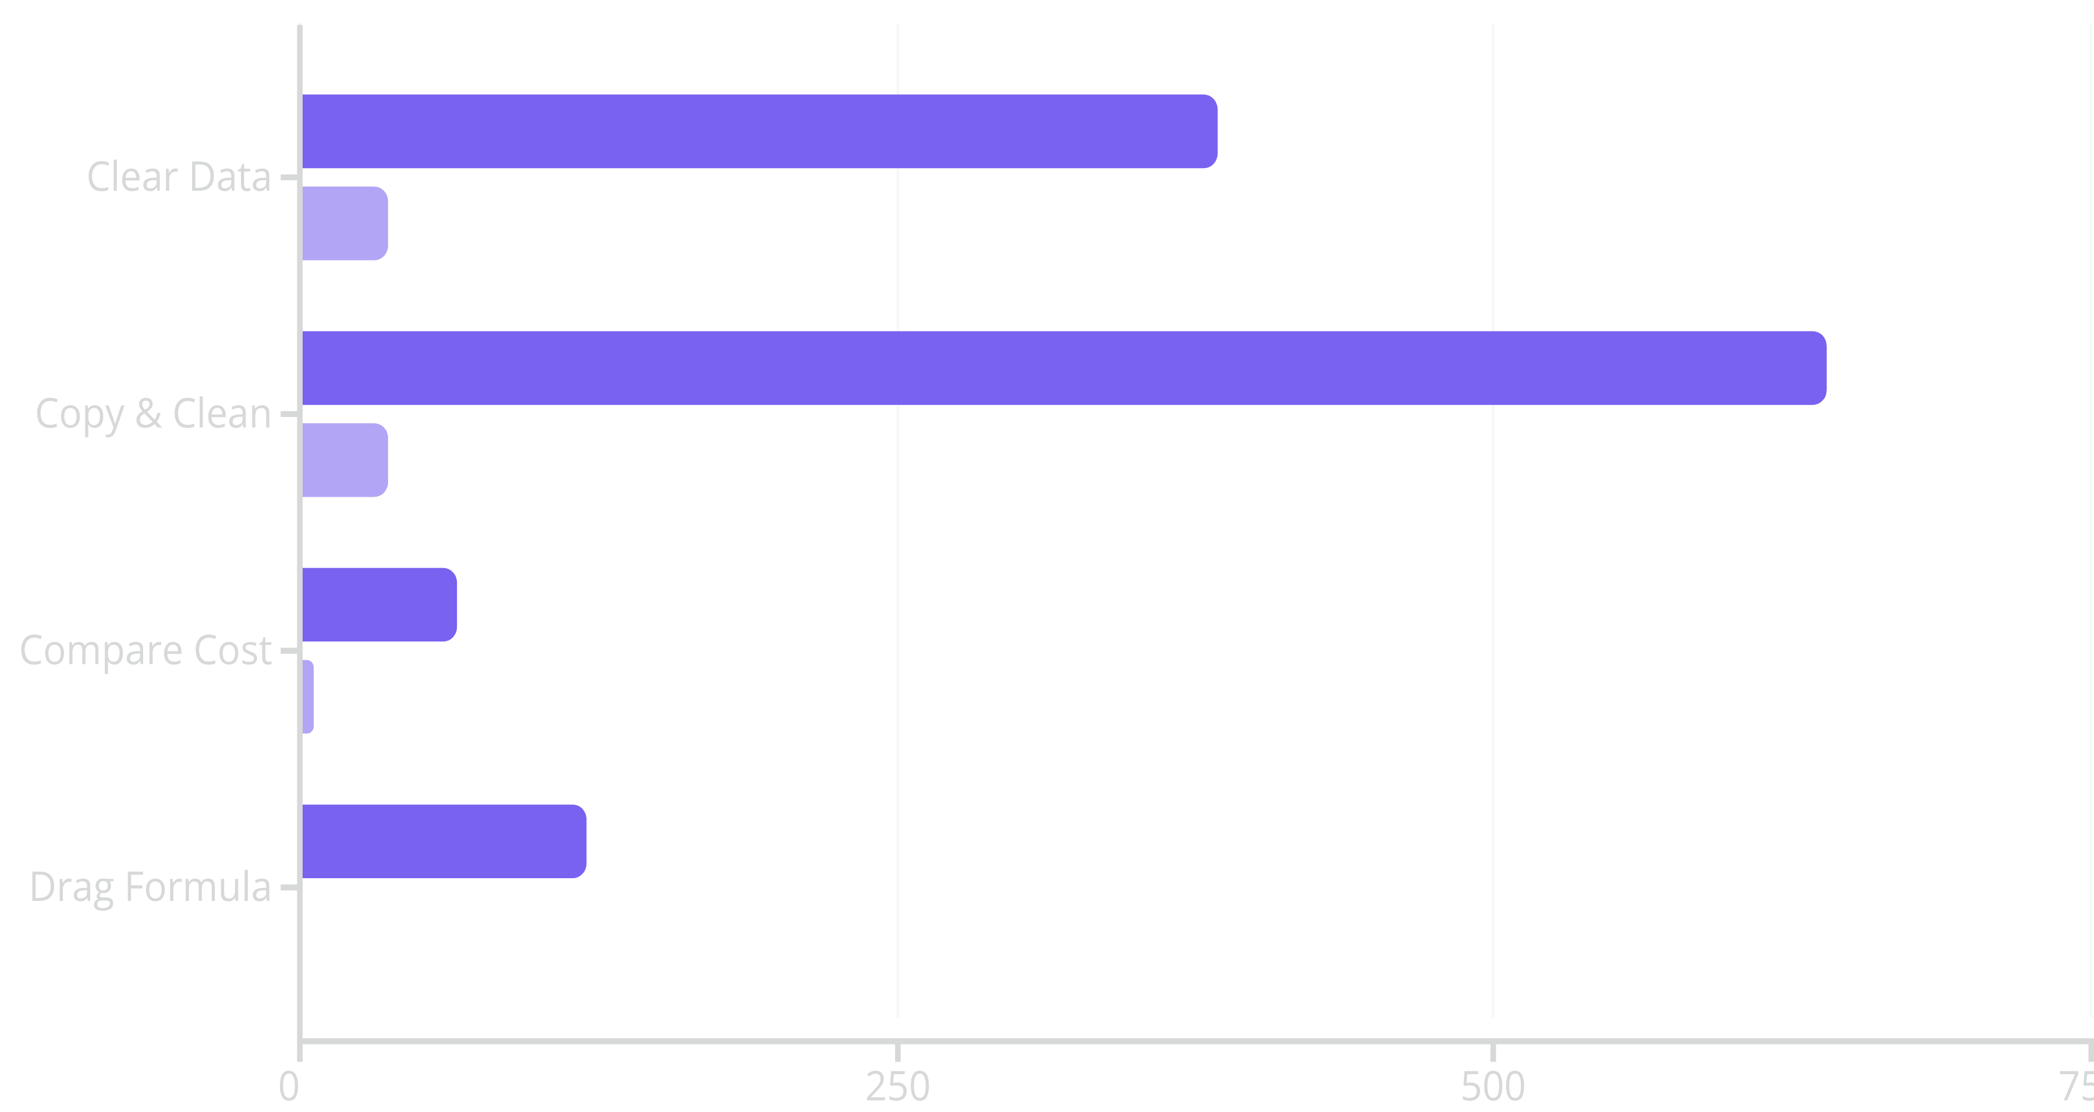

Python vs Excel: Performance Comparison
Python demonstrates significant time savings across key data processing tasks
Python (seconds)
Excel (seconds)
Note: Python processing times exclude conversion to Excel format. Clean raw data: 37min (pandas to xlsx, 254MB) vs 4min (pandas to csv, 974MB). Output creation: 3min 29s without formatting, up to 5min with formatting (19MB).

Slide 5

Project Teams
Coding Team
Bhushan
Jyoti
Nikita
Shivam
Shraddha
Suhail
Testing Team
Abhinav
Bhaskar
Keerthana
Saritha
Vijay
MyExpense Team
Abhinav
Bhaskar
Jyoti
Keerthana
Shraddha
Suhail
SAP Team
Bhushan
Ishan
Nikita
Saritha
Shivam
Vijay

Slide 6
11-Week Implementation Timeline
Weeks 1-2
1
Initial planning, process session, and company car script creation
2
Weeks 3-4
Architecture and GUI design, code consolidation and design changes
Weeks 5-6
3
GUI code development, script testing, and GUI-script incorporation
4
Week 7
Processing of December data
Weeks 8-9
5
Issue fixes, SAP incorporation changes, and SAP data testing
6
Weeks 10-11
Overall process testing and real-time SAP and MyExpense processing
Project Duration: November 24, 2025 - February 13, 2026

Slide 7


Why Python?
Performance
Processes large datasets significantly faster than Excel, handling over 100K rows efficiently
Scalability
Highly scalable solution with easy testing integration and automation capabilities
User-Friendly
GUI creation enables non-technical users to leverage powerful data processing
Validation
Easy validation and debugging with consolidated testing in one file

